Slide 1
GPRS CRIME TRACKING
Prepared By:
Zil Mehta(03)
Parin Modi(31)
Ankita Lachhwani(60)
Keyuri Gajjar(63)
Guided By: Prof. Pariza Kamboj

Slide 2

Industry Defined Project
NAME :- Artoon Solutions Pvt Ltd.
ADDRESS:- C-201,DiamondWorld,
MiniBazar,Varachha Road,
Surat-395006, Gujarat,
INDIA.

Slide 3
Problem Summary
These days crime rates are increasing, and so, there is a strong need for the common people to prompt the Police officials about the crime on the spot.
Hence, it demands to develop an application that focuses on an interactive interface that will help both the Police officials and the common people to interact about the crime instantly.

Slide 4
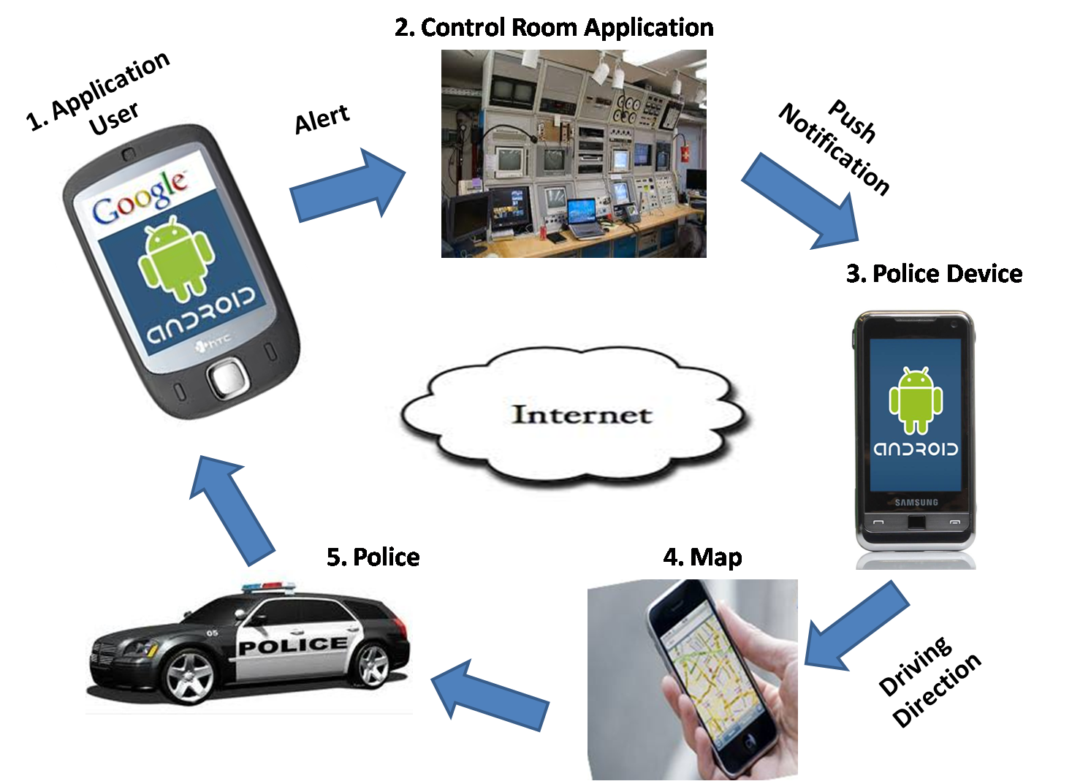

Slide 5
Total Modules in the project

Slide 6
1. Android Application
Normal User
User registration/User login
Ping to police
Text to police
Send image to police
Send video to police
Send alerts(Image/Video/Text)

Slide 7
Police User
Retrieve alert as a push notification
Driving directions till the crime spot

Slide 8
2. Control Room
Login/Registration of admin users and police.
Determine the crime spot through map.
Determine the police officials that are in the range of 5kms.
Send push notification.

Slide 9
3. Website Development
Home page
- Latest city news
- Latest incident (incident location + image / video / message)
Map displaying position of users and police officials.
Listing page where user can see all incidents listing with sorting option (today, weekly, month, year).

Slide 10
TASKS IMPLEMENTED

Slide 11
Android
1)User Registration
When the user creates an account a mail consisting of the verification link will be sent to the users email id .
Once the user clicks on the link, the account of the user will then be activated and the user will be allowed to use the application.

Slide 12
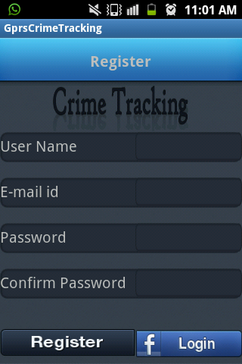
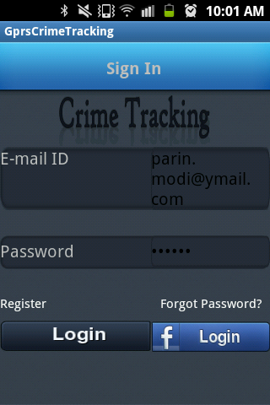
User Registration

Slide 13
2)Edit Profile
Edits the profile of the user.

Slide 14
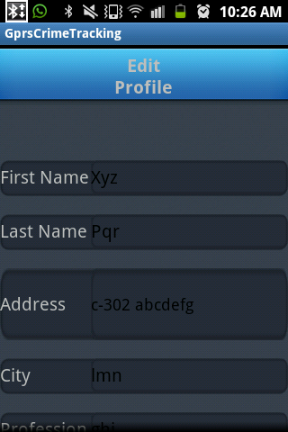
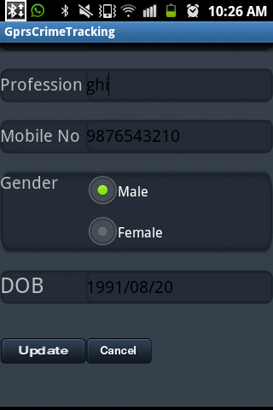
Edit Profile

Slide 15
3)Image Upload
The user can either capture the image or select the image from gallery and can send it to the control room.

Slide 16
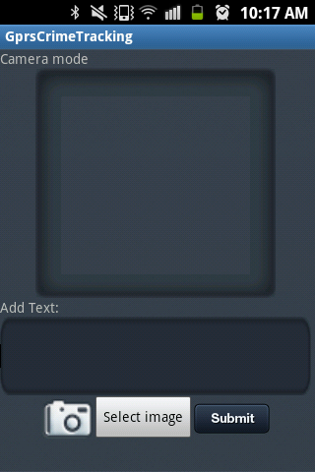
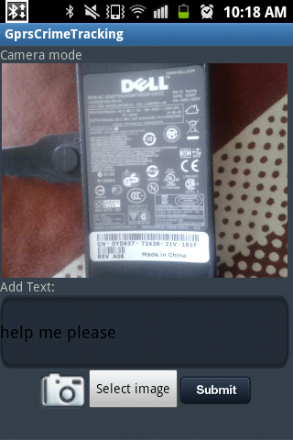
Image Capture

Slide 17
4)Text
The user can type a text and can send as an alert to the control room.

Slide 18
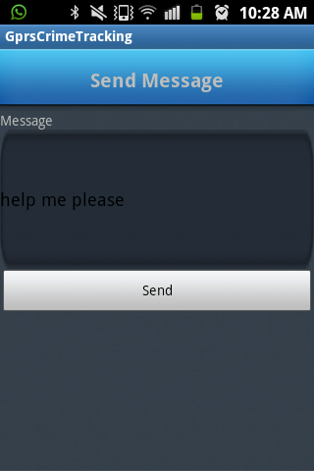
Text

Slide 19
5) Video Upload
Calling the in-built camcorder to record the video of crime and sending to control room.
Option to playback the video.
Media Controller options on video.

Slide 20
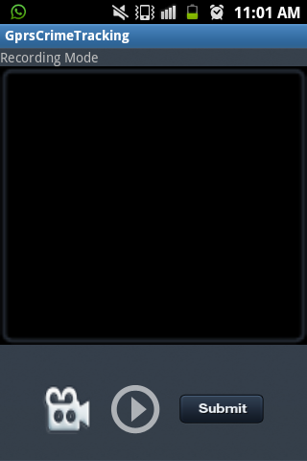
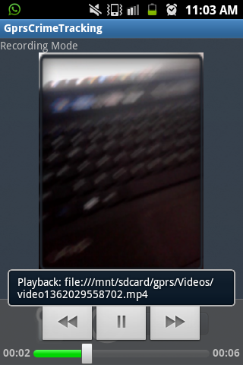
Video

Slide 21
6) Map Implementation
There are two ways to retrieve the location of the user:
GPS : This provider determines location using satellites. Depending on conditions, this provider may take a while to return a location fix.
Network : This provider determines location based on availability of cell tower and WiFi access points. Results are retrieved by means of a network lookup.

Slide 22
Why Network Provider Over GPS?
GPS traditionally needs to connect to at least three satellites .
Initial connection to the satellites – Time to First Fix (TTFF) – can be quite slow.
Battery consumption is quite high, and continued use of the the GPS will drain the battery.
The network provider can give first location results within seconds. This is much faster than the GPS location provider.

Slide 23
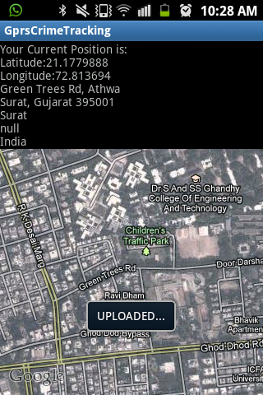
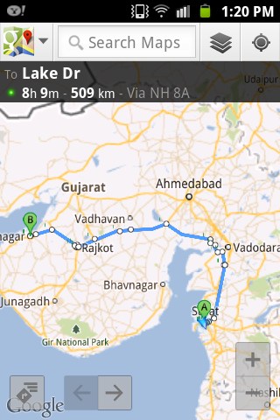
Map
Normal User
Police(Driving Directions)

Slide 24
Website Implementation
Admin Panel
Login/Registration of admin users and police.
Change password by sending mail consisting of new password/Forgot password.
Profile update.
Displaying map for the current location of the application user.

Slide 25
Thank You

